Slide 1
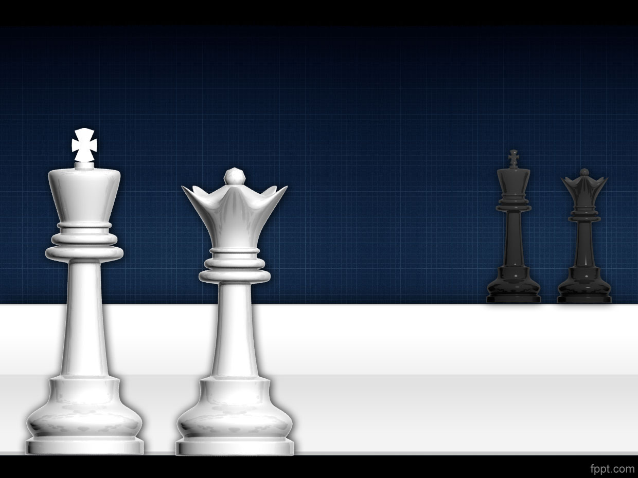
Two Player Board Game
Chess
Rohit.Shindhe
190624325
Matthew Huntbach

Slide 2
Objective
The Main objective of this presentation is how the Alpha-Beta pruning helps in the Chess game.
What is Chess?
What is Pruning
Alpha-Beta pruning?

Slide 3
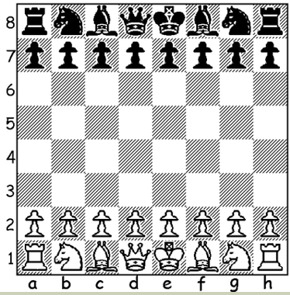
Introduction to Chess
Chess is a two player board game of 8x8 grid.
There are six different coins of two different colors on each side of the game.
Rules: En Passant, Castling, Pawn Promotion, Stalemate, Checkmate.
Coins move in a specified path.

Slide 4
Pruning
Prune means “to trim/eliminate”
Pruning is used to reduce nodes and reach an optimal solution.
Works by blocking the evaluation of nodes.
E.g.: Alpha-Beta pruning.

Slide 5
Alpha-Beta
Alpha-Beta pruning is an optimization technique.
Computation time is reduced.
Based on DFS technique.
Searches faster and goes deeper level.
Eliminate branches which are not required.
Keeps track of the best move for each side.

Slide 6
Alpha-Beta (cont.)
Alpha is the value of the best for the largest i.e. max α (-∞).
Beta is the value of the best for the smallest i.e. min β (∞).
Condition for pruning is based on α ≥ β or β ≤ α

Slide 7
Alpha-Beta Mechanism
Initialize alpha (-∞) and beta (∞) as worst possible cases.
The condition is to prune a node when α ≥ β.
Start assigning values to both and since alpha is less than beta we don’t prune it.
Continue these values to child node on the left. From utility value of terminal we get values and when condition is satisfied prune that branch.

Slide 8
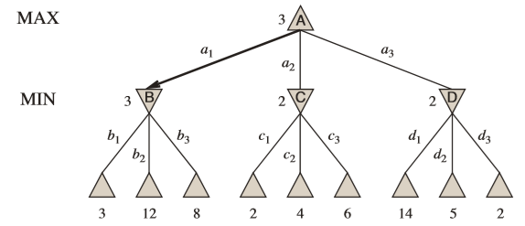
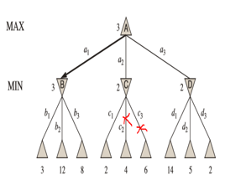
Working of Algorithm
Minimax
Alpha-Beta

Slide 9
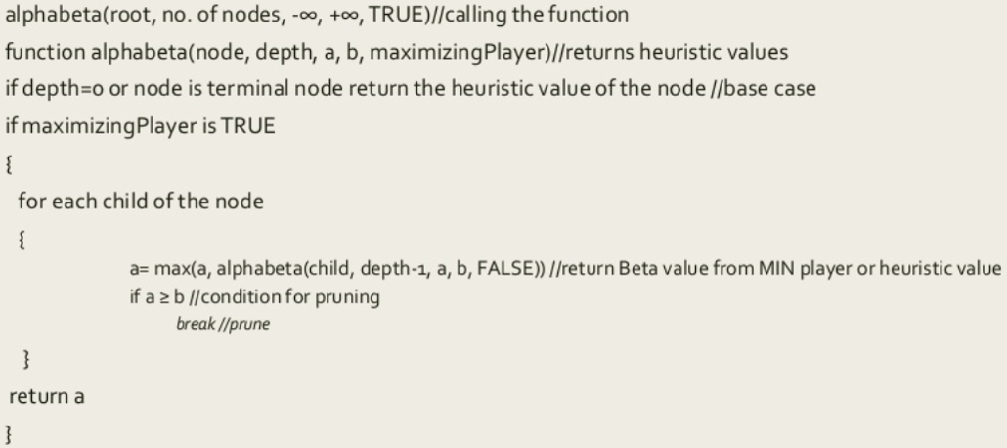
Pseudocode

Slide 10
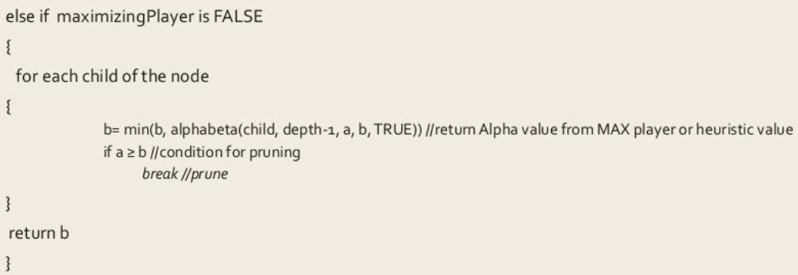
Pseudocode (cont.)

Slide 11
Advantages of Alpha-Beta algorithm
It prunes the complete unwanted branch in the search tree.
Optimization reduces the effective depth almost double of minimax.
Efficiency increases, Timing decreases.

Slide 12
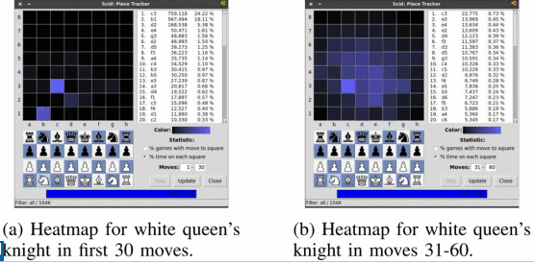
Future Improvements
Coin Counter.
Database using Heatmap.
Network Design.
Simulation with GAN’s (Generative Adversarial Network)

Slide 13
Conclusion
Alpha-Beta Pruning Algorithm has been extremely successful in improving the ability of chess playing engines through its optimality.

Slide 14
Thank you

